Slide 1
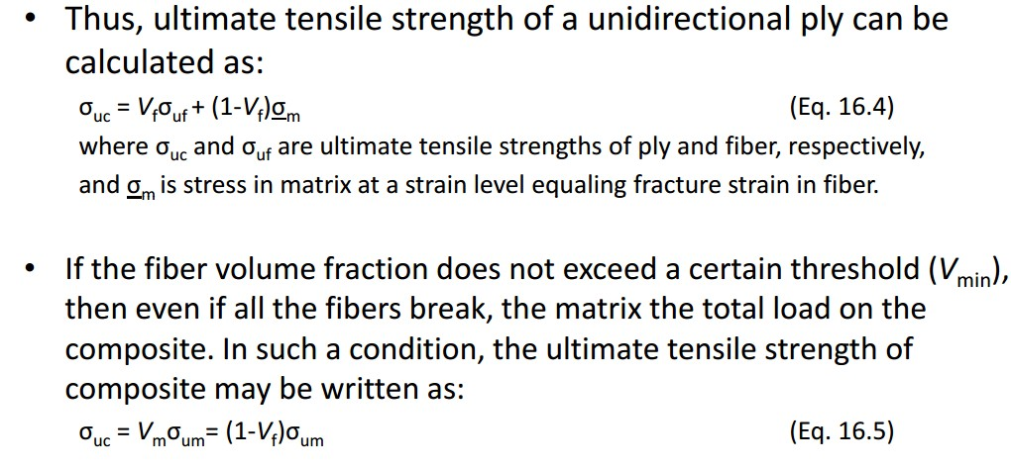
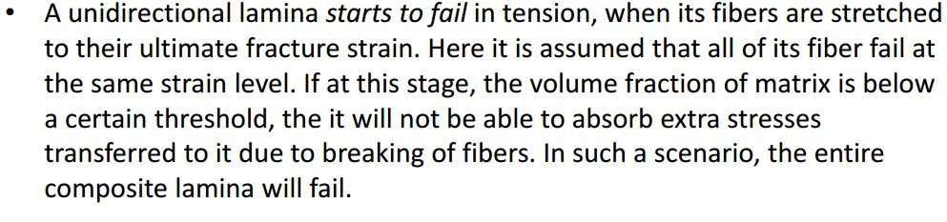
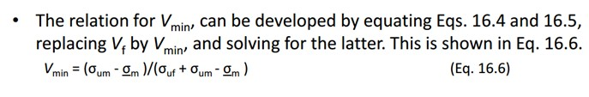
Assist.Prof.Dr. Dhia ahmed

Slide 2
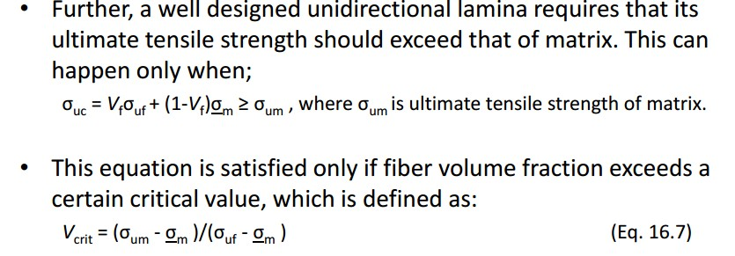
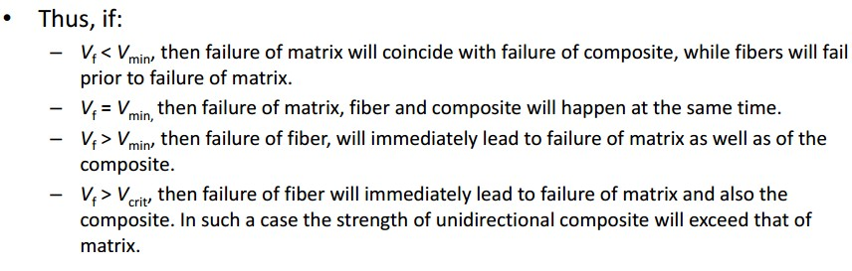
Assist.Prof.Dr. Dhia ahmed
Example: A hybrid composite consists of two different types of fiber in an epoxy matrix. Using the properties of the constituents given below, draw the stress- strain diagram for the composite tested to failure in an elongation maintained test. Assume all constituents fail in a brittle manner.

Slide 3
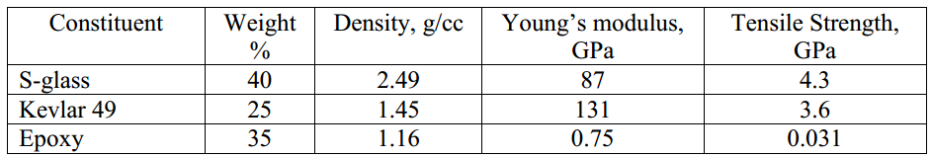
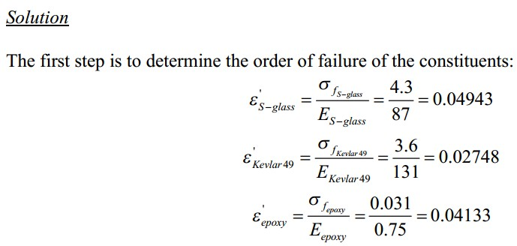
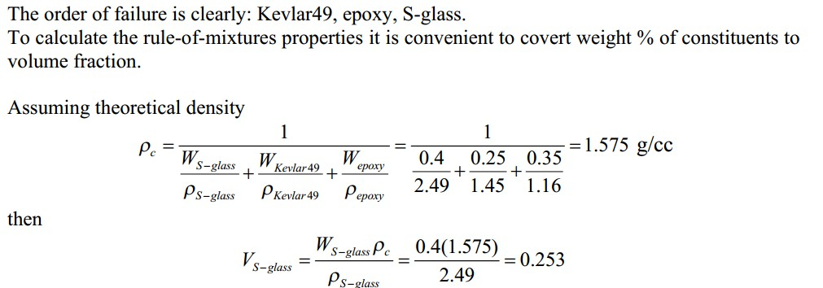
Assist.Prof.Dr. Dhia ahmed

Slide 4
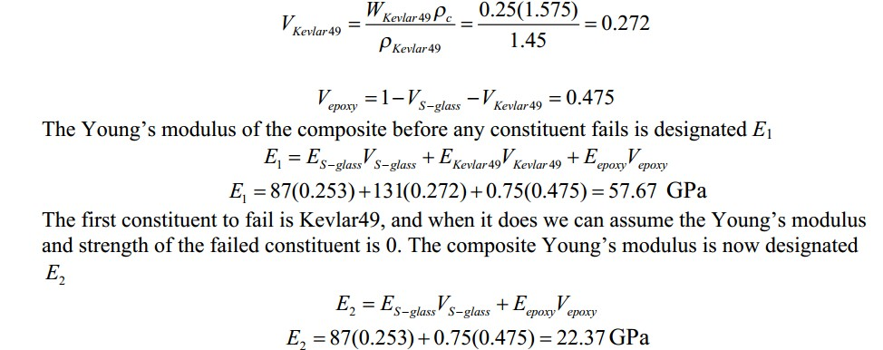
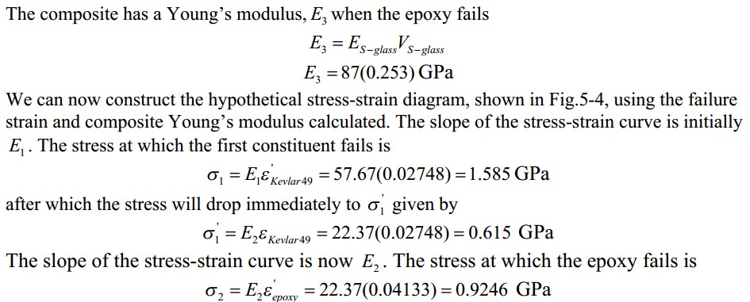

Assist.Prof.Dr. Dhia ahmed

Slide 5
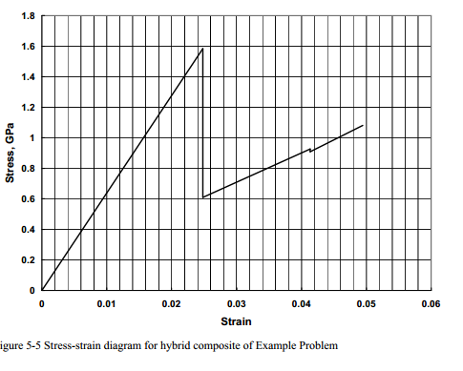
Assist.Prof.Dr. Dhia ahmed
q- How to calculate fiber volume fraction while making the composite, as the epoxy and the glass represent the matrix and reinforcement respectively. Given the information below:
mold size : 15*16*2.5 in cm3 wt of fiber =33.045g
density of glass fiber = 2.54 g/cc sol.
Hence volume of mold =15*16*2.5= 62 cm3

Slide 6
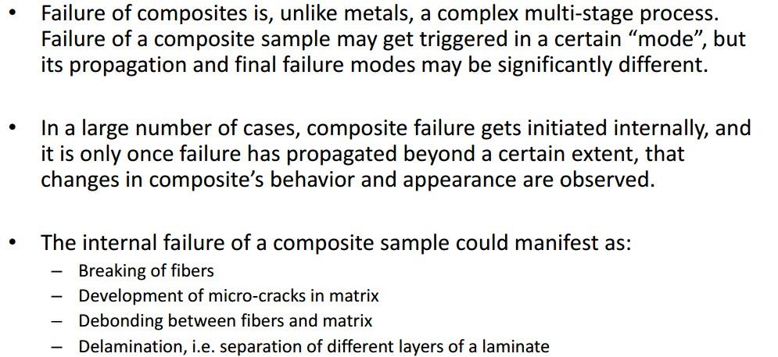
Assist.Prof.Dr. Dhia ahmed
0.2098
To get the weight of the resin
1.15 * 48.99= 56.33g
This means we use a weight of resin 56.33 when the fiber weight 33.045 as well as we use a fiber volume fraction of 0.2098 when the mold thickness is 2.5

Slide 7
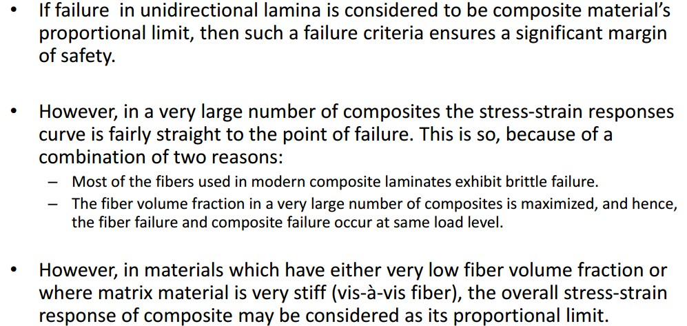

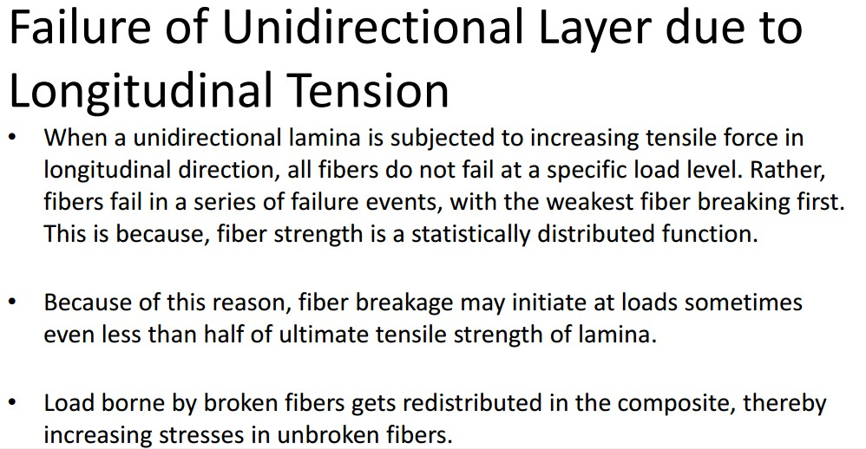
Assist.Prof.Dr. Dhia ahmed

Slide 8
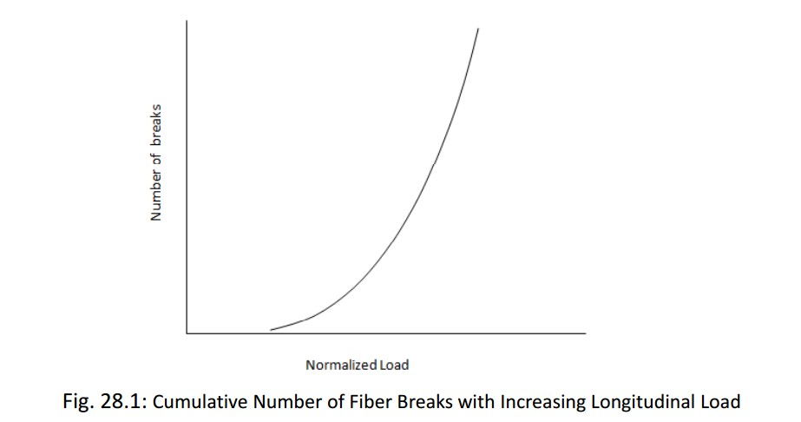
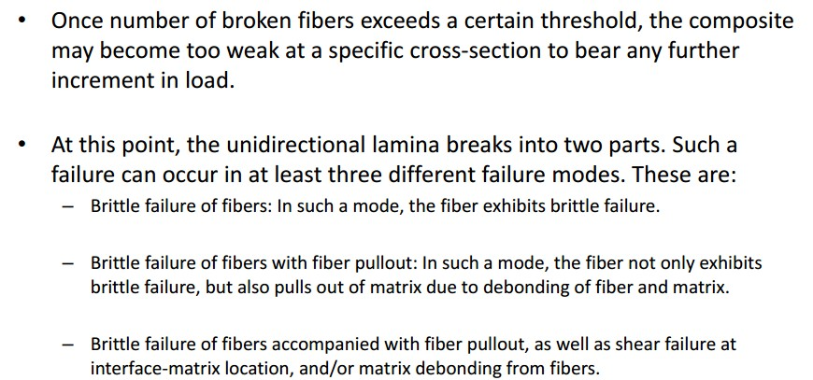

Assist.Prof.Dr. Dhia ahmed

Slide 9
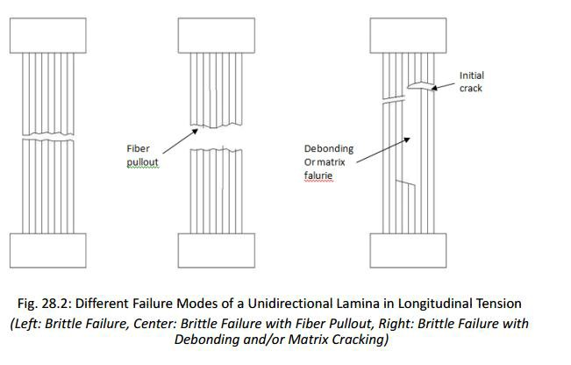
Assist.Prof.Dr. Dhia ahmed

Slide 10
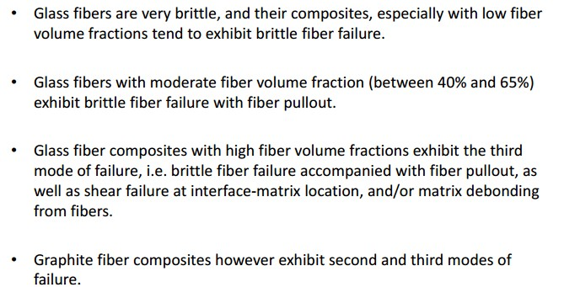
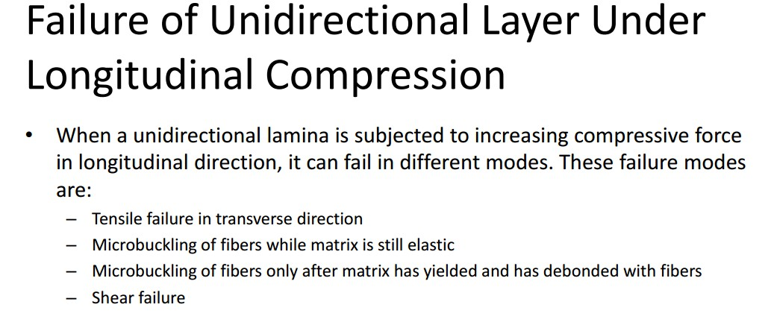
Assist.Prof.Dr. Dhia ahmed

Slide 11
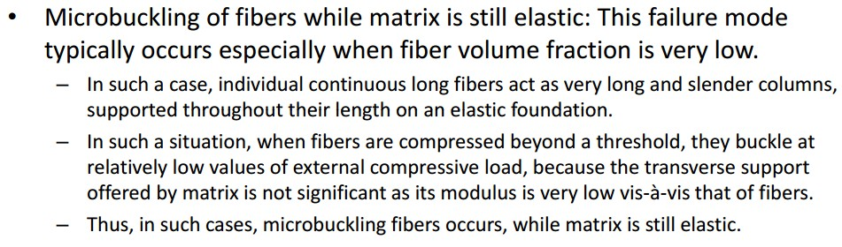
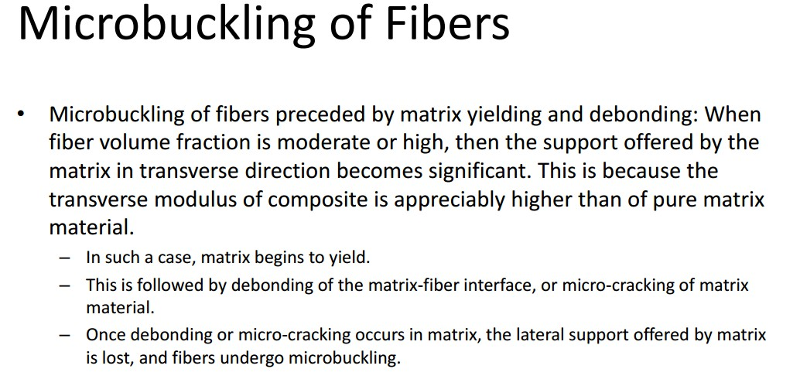
Assist.Prof.Dr. Dhia ahmed

Slide 12
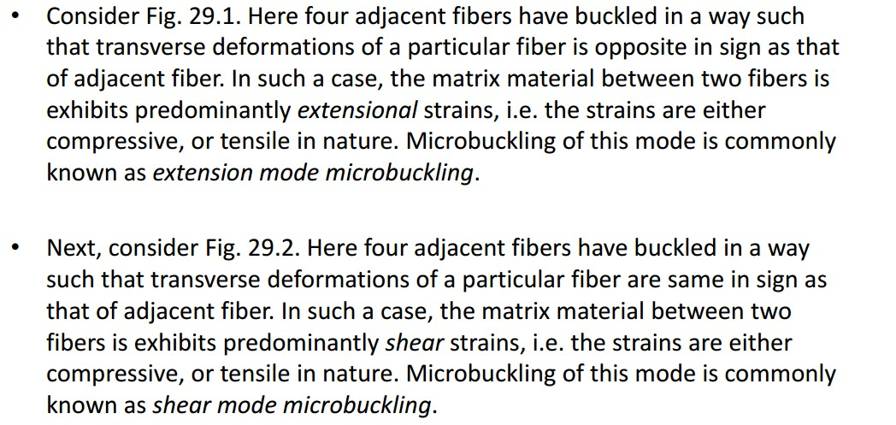
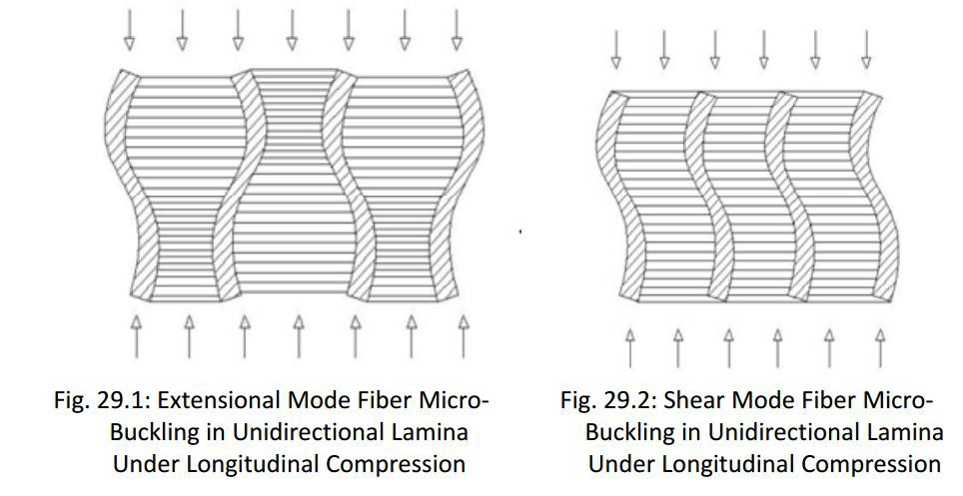
Assist.Prof.Dr. Dhia ahmed

Slide 13
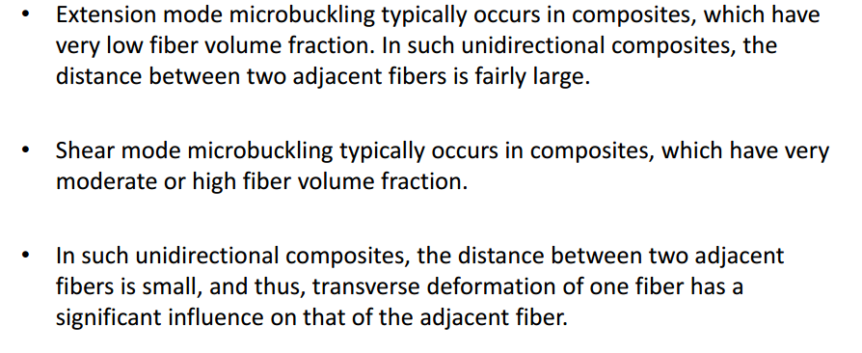
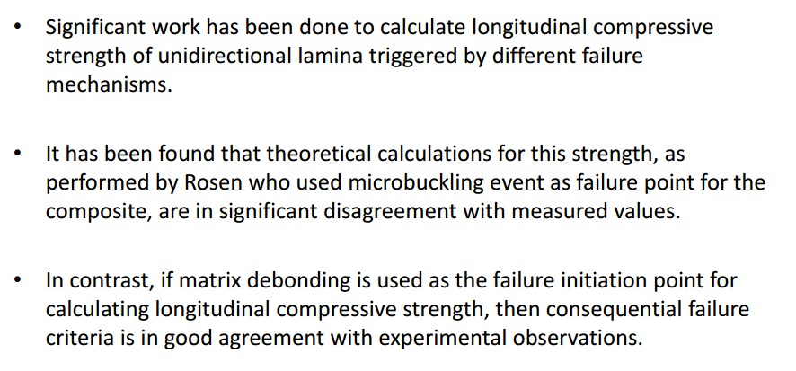
Assist.Prof.Dr. Dhia ahmed

Slide 14
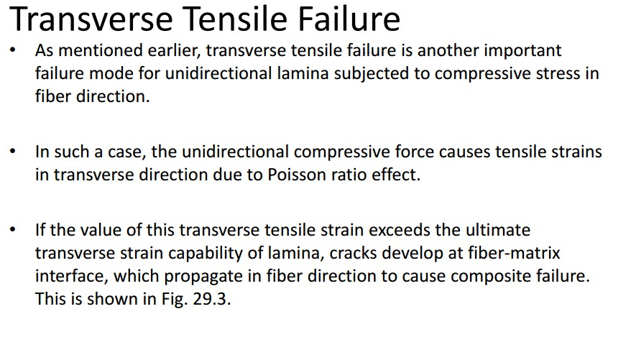
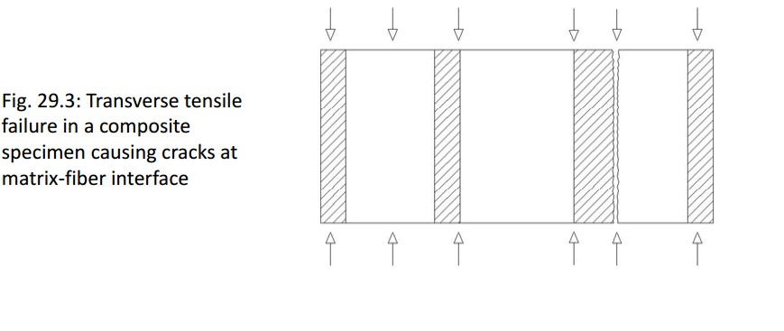
Assist.Prof.Dr. Dhia ahmed

Slide 15
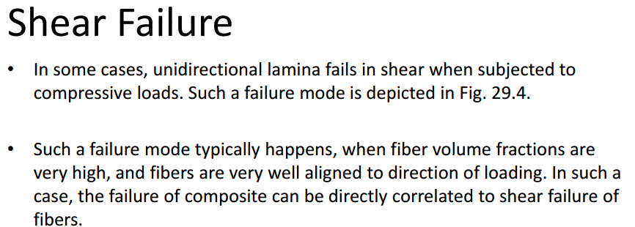
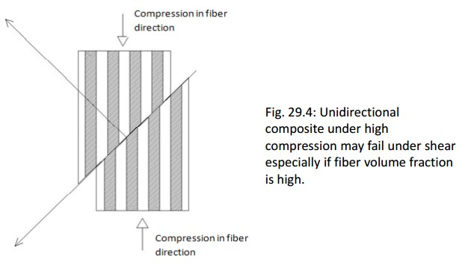
Assist.Prof.Dr. Dhia ahmed

Slide 16

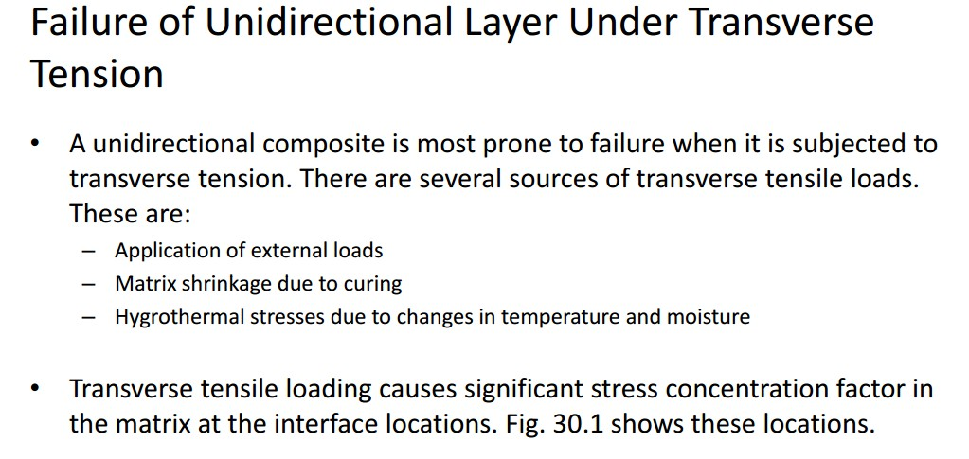
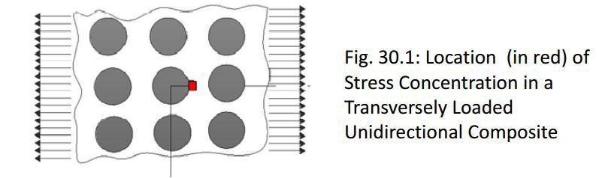
Assist.Prof.Dr. Dhia ahmed

Slide 17
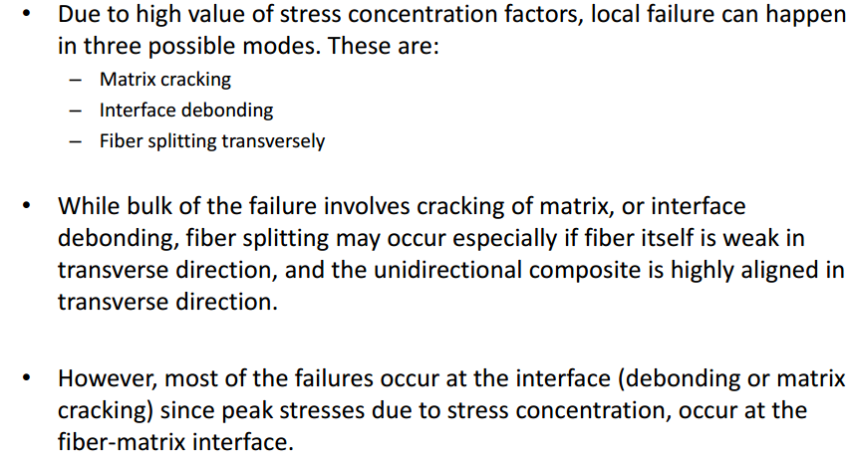
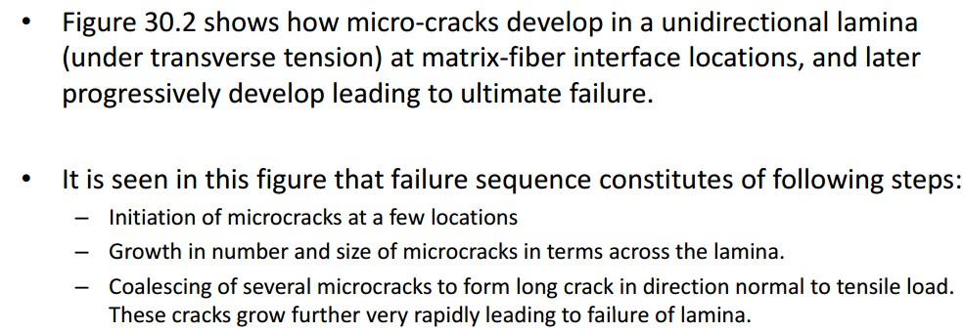
Assist.Prof.Dr. Dhia ahmed

Slide 18
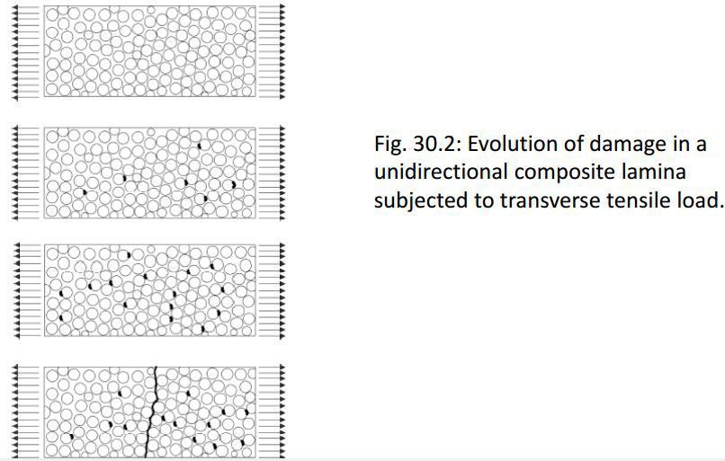
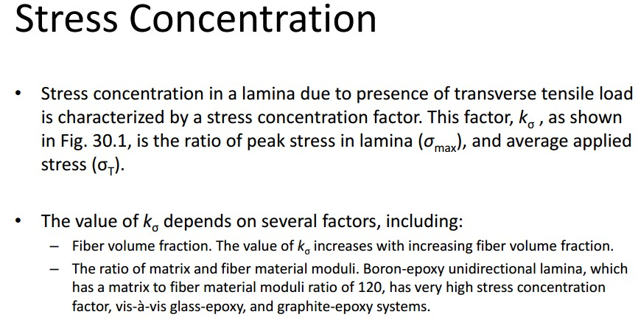
Assist.Prof.Dr. Dhia ahmed

Slide 19

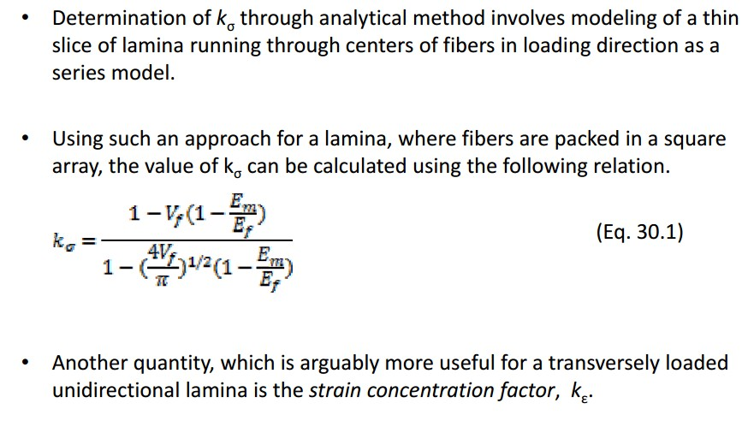
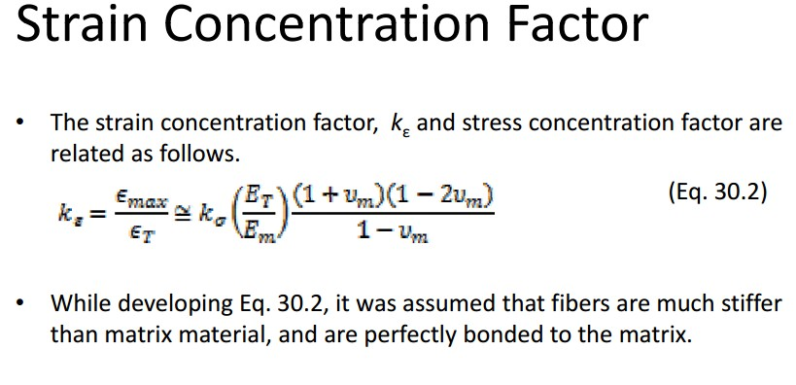
Assist.Prof.Dr. Dhia ahmed

Slide 20
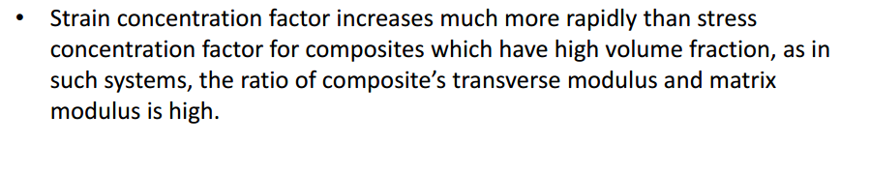
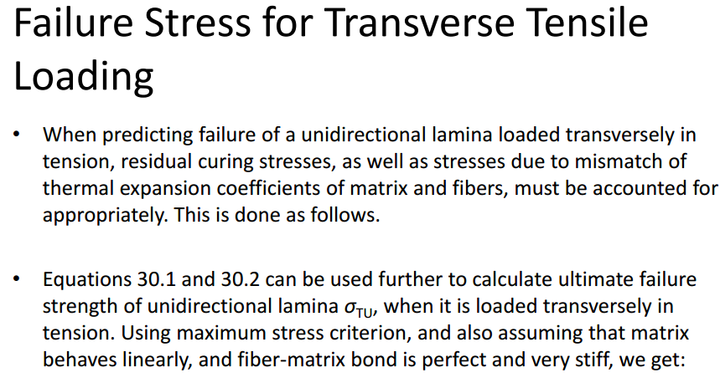
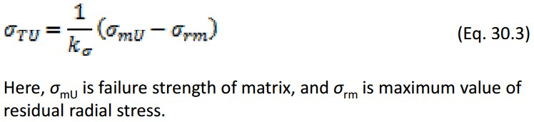
Assist.Prof.Dr. Dhia ahmed

Slide 21
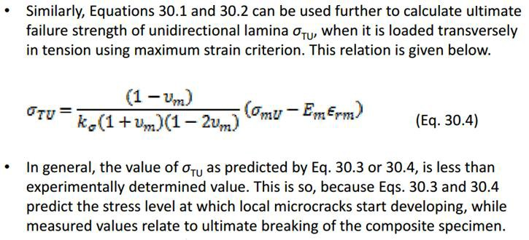
Assist.Prof.Dr. Dhia ahmed

Slide 22
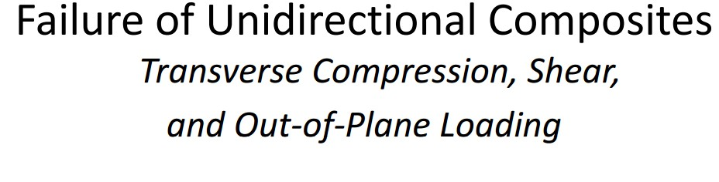
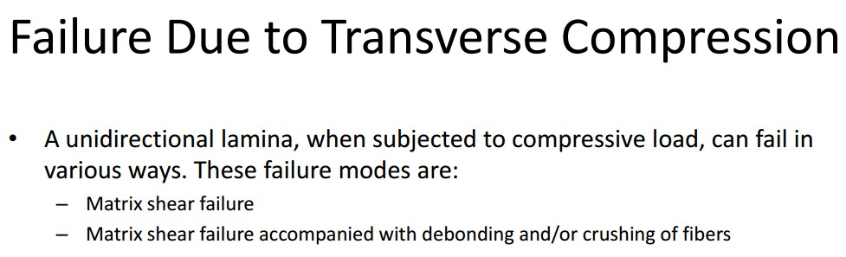
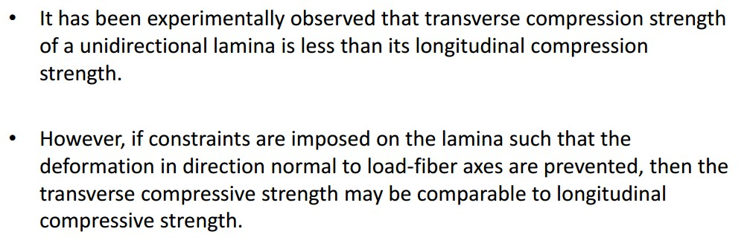
Assist.Prof.Dr. Dhia ahmed

Slide 23

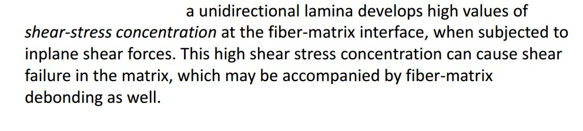
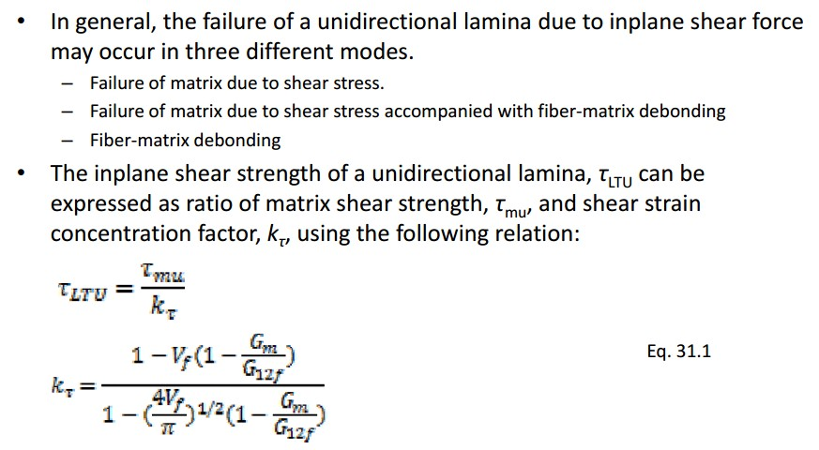
Assist.Prof.Dr. Dhia ahmed

Slide 24
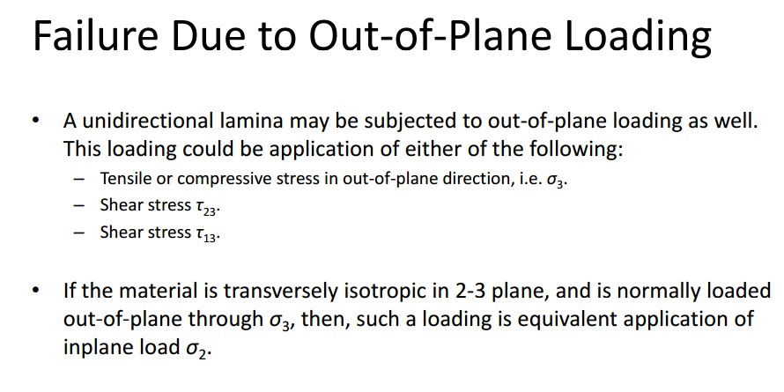
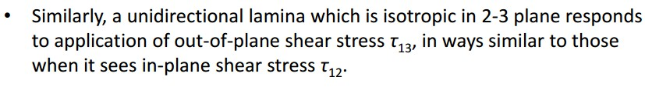
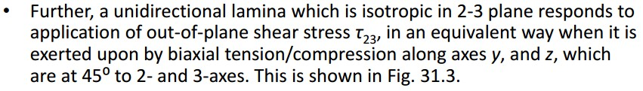
Assist.Prof.Dr. Dhia ahmed

Slide 25
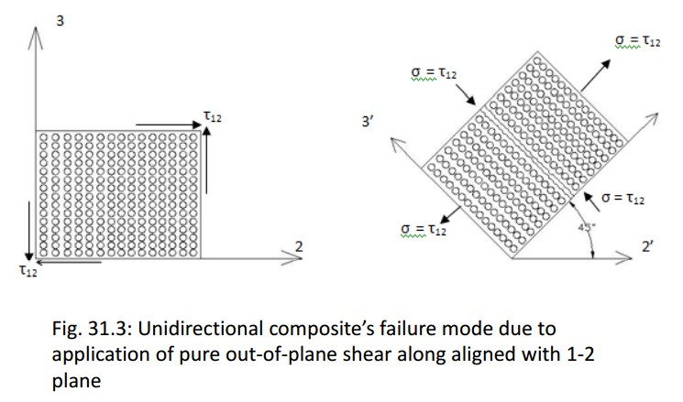

Assist.Prof.Dr. Dhia ahmed

